Slide 1
Celebrated Leader
Presentation By : Jigyasa Sharma (ID 219664380)
Sahil Rana (ID219668980)
Jinalkumar Doshi (ID 219636260)
Sumeet Singh (ID 219634580)

Slide 2
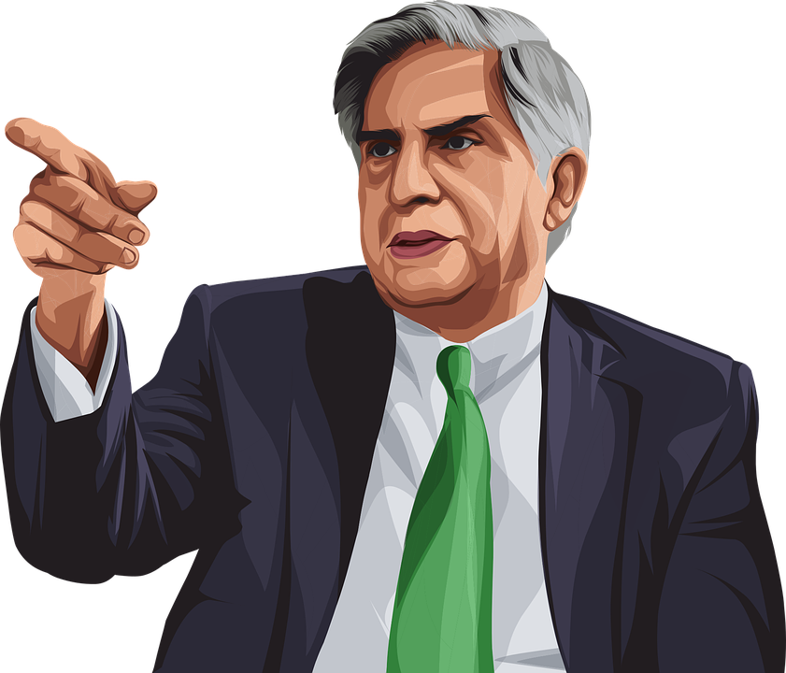
Introduction : Ratan Naval Tata
Ratan Tata is the current board of director of Tata Sons. He was born in the Indian city of Bombay.
He has received two of India's highest civilian awards, the Padma Vibhushan (2008) and Padma Bhushan (2000).
He joined Tata in 1961 and supervised the acquisitions of Tetley, Jaguar Land Rover, and Corus by Tata Tea, Tata Motors, and Tata Steel, to transform the company from an India-centric enterprise to a worldwide one.

Slide 3
FOUR :XLQ MODEL CONCEPTS

Slide 4
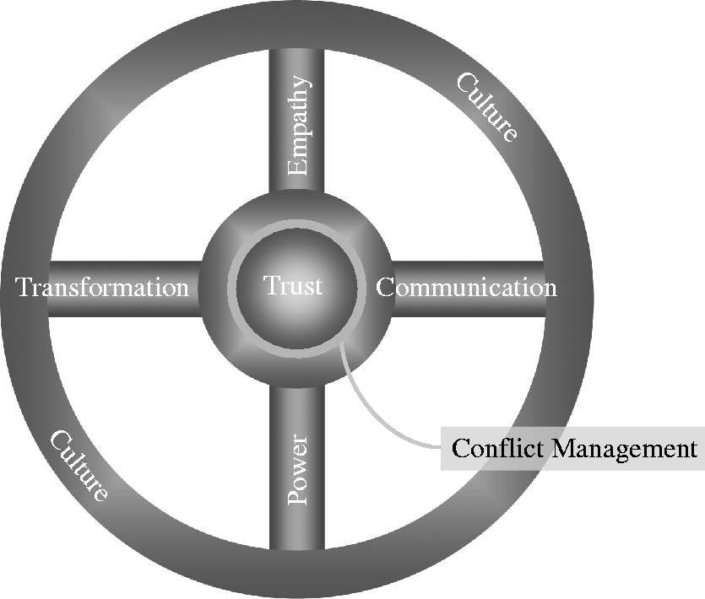

Slide 5
Communication
LISTEN
Communicate your vision “clearly and often” to people (your team, your customer) who assists you on road to success.
Believes that one-way communication is rarely effective communication.
One of Ratan Tata’s standout qualities is his leadership communication, which was with him when he joined the Tata Group in 1961
VISION
“Far more is gained by walking on the shop floor and communicating with the people. Communication is an exceedingly important function for any chairman to do and to be visible in that sense. "Ratan Tata
CLARITY

Slide 6
EMPATHY
Ratan Tata is a great leader with many leadership traits one of which is empathy which he has followed throughout his life.
When Covid had hit the world people were getting laid off all over, that is when Ratan Tata stood up and made a statement to show empathy to the stakeholder, shareholders, and employees.
Tata Group was one of few companies during the pandemic which didn’t have any layoffs apart from that he also made sure that different subsidiaries were compensated by Tata Trust.
Another instance where he followed empathy was when there was a strike in the Tata Motors factory in 2008, where he had stood up with all his employees and met their demands of giving out bonuses. Later on, the employees themselves declined to take the bonus. This is a perfect example of how empathy helps great leaders.
Ratan Tata has also contributed to various activities in India to help develop the nation he established Tata Memorial Hospital where each person is treated for free. This shows how great a leader he is and how empathy worked for him.

Slide 7

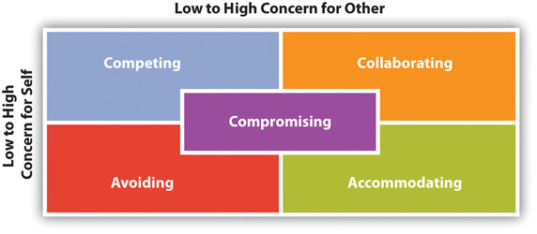
Conflict Management
Ratan Tata is a man of words and an excellent conflict solver.
Solved the Mystery-TATA conflict in an efficient and risk-free way.
Solved the land acquisition issue, when TATA group wanted to build a plant for TATA Nano(Cheapest Indian Car).
Managed the retirement conflict when inside the company the retirement age was reduced to 65 years from 70.
A true leader knows how a conflict can occur and how it can create a healthy environment in the organization itself.

Slide 8

Trust
One of the oldest brands of India, which directly relates to the one hierarchy of family.
The calmness in the style of his work and taking all the issues in a well-mannered way.
A brilliant speaker, who knows what the audience wants to listen to.
Always, giving the best in terms of services and products.
Mostly, the new services that are introduced by the Indian government, like unique identification card(AADHAR), the whole operation was handled by TCS(Tata Consultancy Services)
Recently, the only government-funded airline (Air India) was also bought back by TATA groups.

Slide 9
CONCLUSION
Ratan Tata is one of the most inspiring and transformational leaders. He has a charismatic personality and a vision of success. The management style he adopted is Consensus which tells a lot about how much he values his employees and team’s opinion. He inspires people with his vision and humility. His eye for thoughtful strategic and human judgments made him stand out as a leader.
A visionary, empathic, powerful, and charismatic leader with exceptional communication abilities in the profound sense and character.

Slide 10
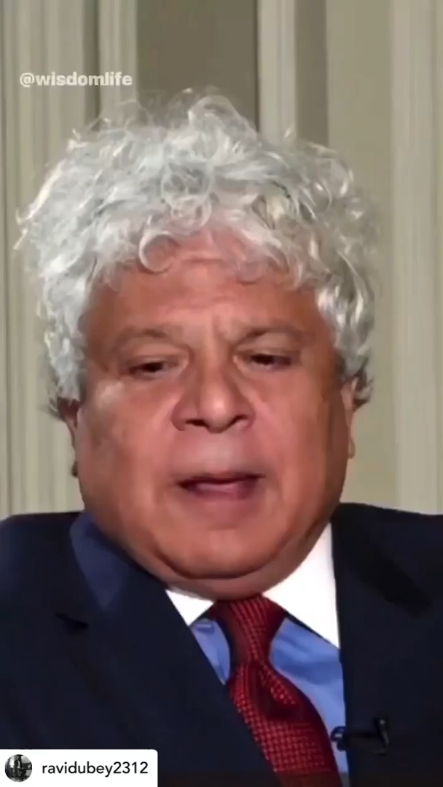

Slide 11
THANKYOU

Slide 12
References
Tiwari, P. M. (2016). Pride of the Nation: Ratan Tata. Diamond Pocket Books Pvt Ltd.
Harris, J. (1989). The Webbs, the Charity Organization Society and the Ratan Tata Foundation: social policy from the perspective of 1912. In The goals of social policy (pp. 27-63). Routledge.
5 Leadership Lessons From Ratan Tata. (2022). Retrieved 30 March 2022, from https://www.shethepeople.tv/news/5-leadership-lessons-from-ratan-tata/#:~:text=Under%20his%20leadership%20Tata%20acquired,Land%20Rover%2C%20and%20Taj%20Boston.&text=2.,collar%20employee%20for%20Tata%20Steel.
8 LEADERSHIP LESSONS OF SIR RATAN TATA YOU WISH YOU KNEW BEFORE. (2022). Retrieved 30 March 2022, from https://www.linkedin.com/pulse/8-leadership-lessons-sir-ratan-tata-you-wish-knew-before-mohit-varma/
Ratan Tata designs, themes, templates and downloadable graphic elements on Dribbble. (2022). Retrieved 30 March 2022, from https://dribbble.com/tags/ratan_tata
Redirecting... (2022). Retrieved 30 March 2022, from https://www.facebook.com/KJAlphons/videos/538697304148074/
Ratan Tata on how empathy played a huge role in overcoming challenges. (2022). Retrieved 30 March 2022, from https://yourstory.com/2020/07/ratan-tata-jlr-empathy-challenges-leadership-talks/amp

